Slide 1
The Whackiton 3D printed guitar phone mount
It's time to invest in a guitar phone mount
Already designed in 3D
Already prototyped
Pay $1 per production popout
or buy the copyright and pay off a virtuous sensitive new age boomer's HECS debt

Slide 2
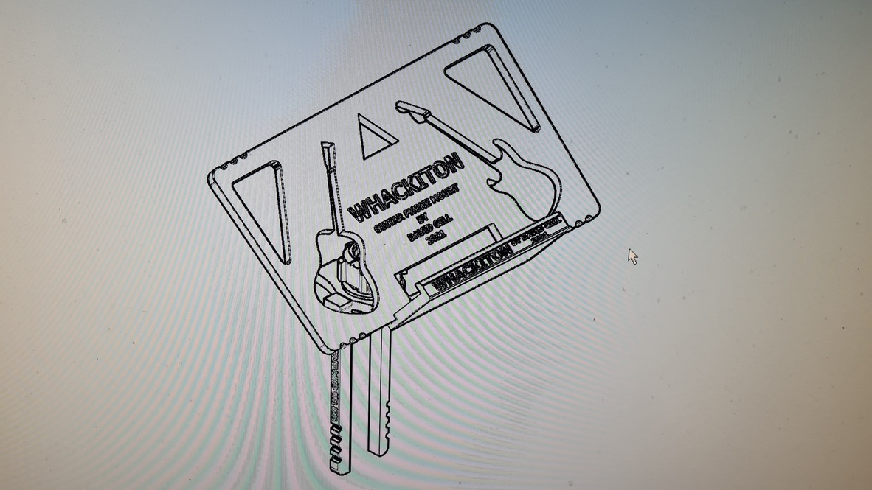
SENSITIVE NEW AGE BOOMER

Slide 3
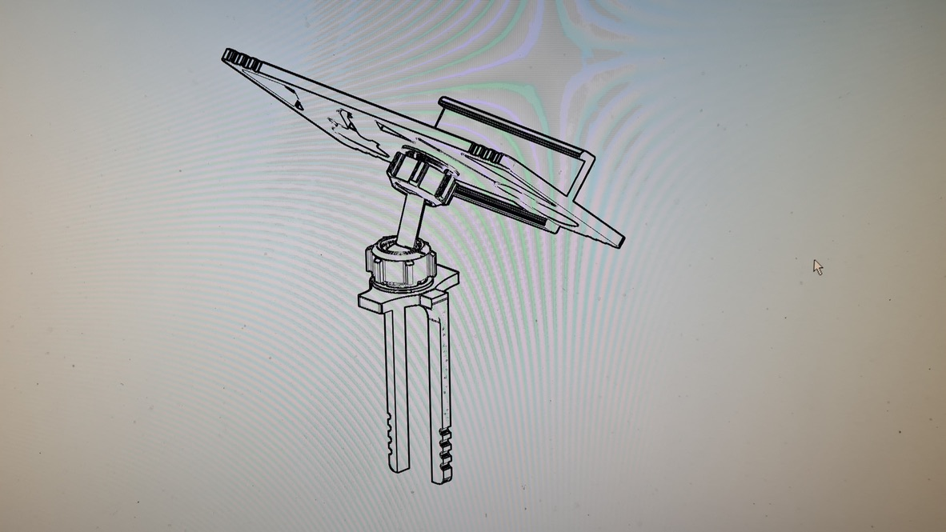

Slide 4
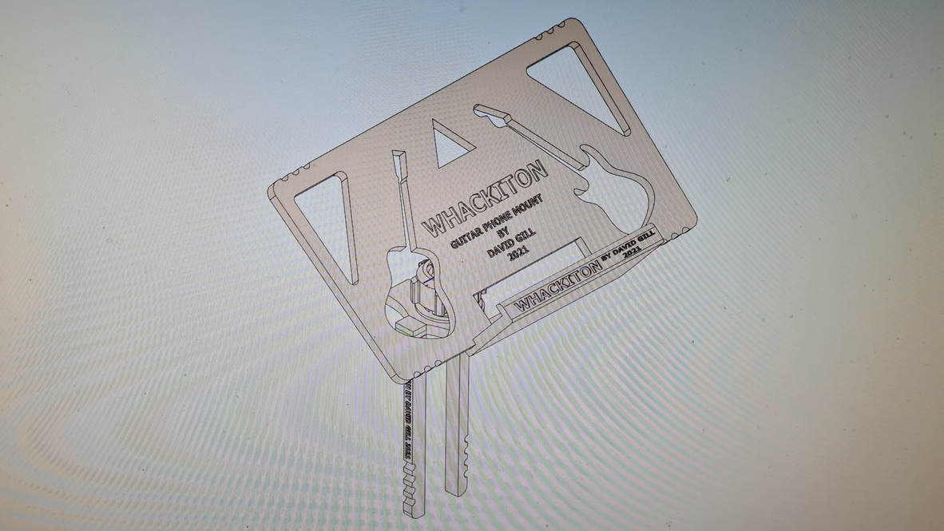
SENSITIVE NEW AGE BOOMER
BY SENSITIVE NEW AGE BOOMER

Slide 5
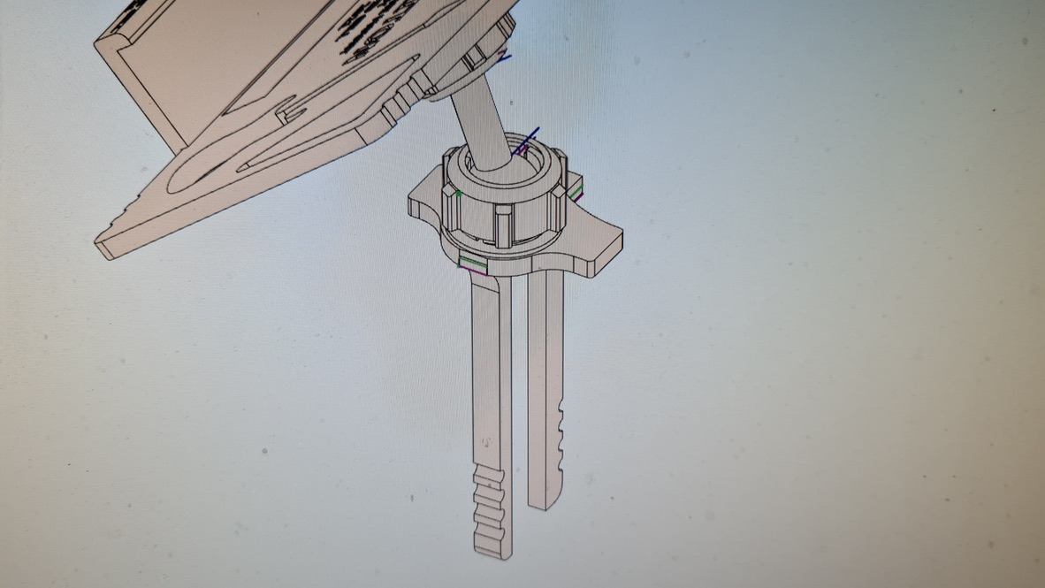

Slide 6
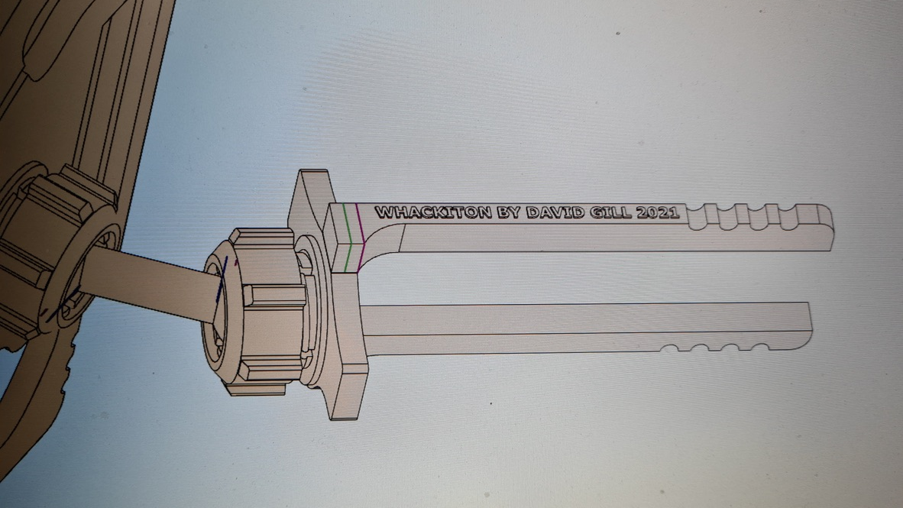

Slide 7
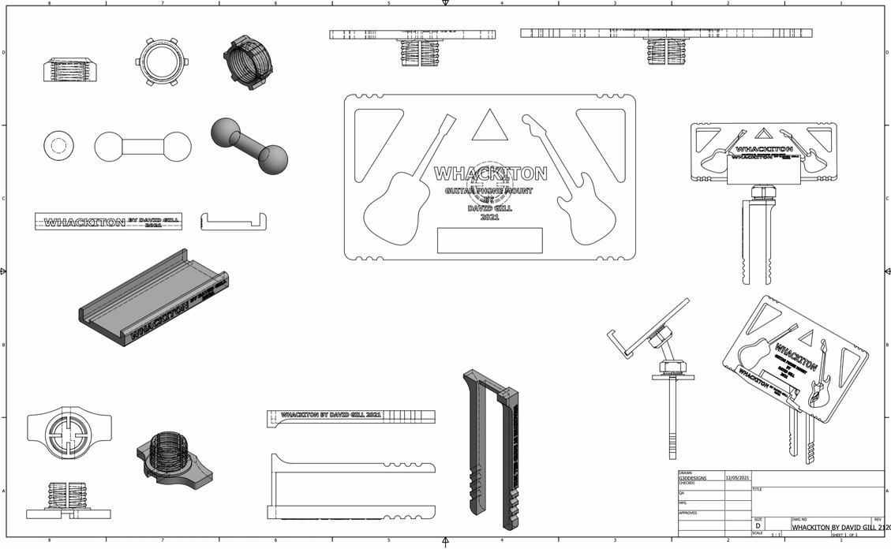
SENSITIVE NEW AGE BOOMER
SENSITIVE NEW AGE BOOMER

Slide 8
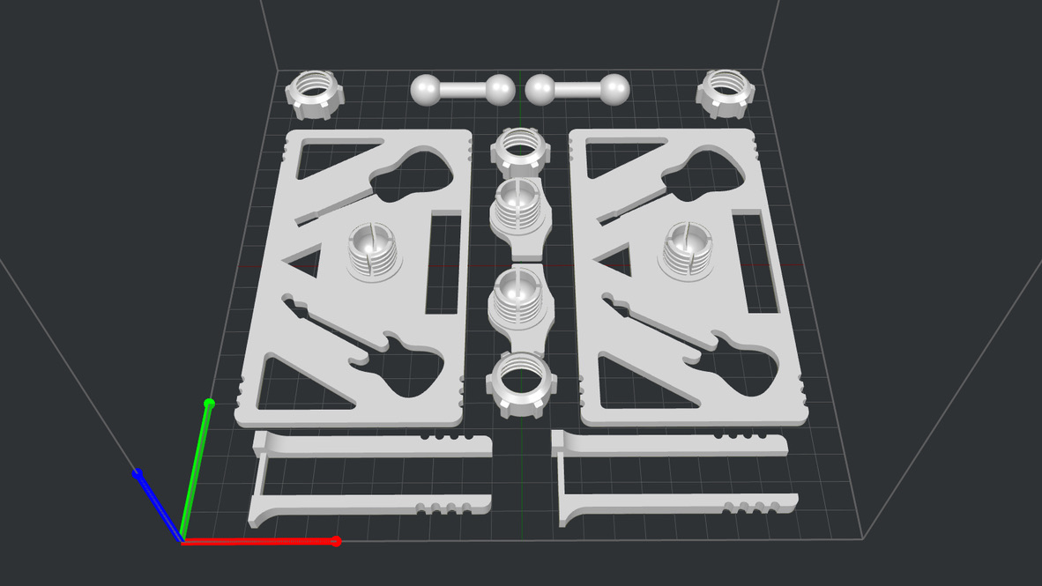

Slide 9
The Whackiton 3D printed guitar phone mount
It's time to invest in a guitar phone mount
Already designed in 3D
Already prototyped
Pay $1 per production popout
or buy the copyright and pay off a virtuous sensitive new age boomer's HECS debt

