Slide 1
Shovel wielding volunteers
required
for a worthy cause …

Slide 2
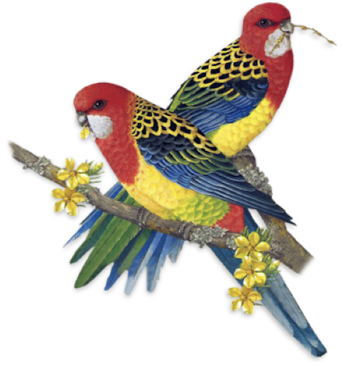
rosella breeding site in need of native grasses, native trees and breeding holes
environmentally sensitive reverse parking …
gate
access

Slide 3
ACT government seed nursery for native grasses and native trees
rosella breeding site in need of native grasses, native trees and breeding holes

Slide 4
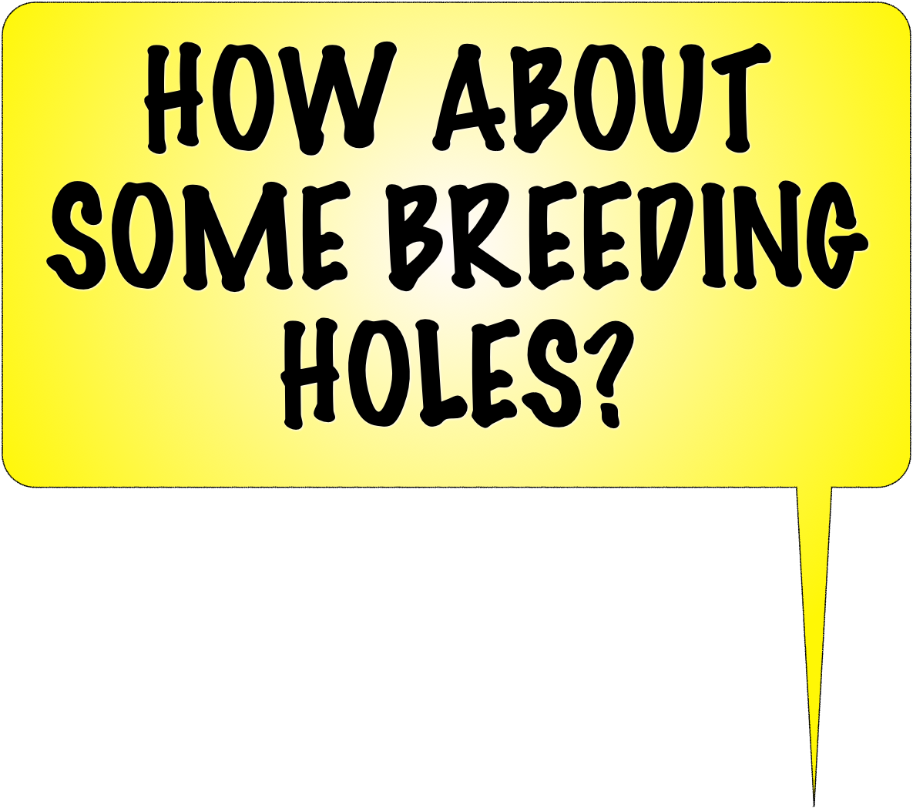
ACT government seed nursery for native grasses and native trees
gate
access

Slide 5
So far …
2023
MAY
JUNE
JULY
AUGUST
SEPT
OCT
NOV
DEC

Slide 6
So far …
2023
MAY
JUNE
JULY
AUGUST
SEPT
OCT
NOV
DEC

Slide 7
1
peel back small (3x4m) amoeba shaped patches of exotic grass
2
shake off the dirt and heap the exotic grass in the centre to compost
3
dig a small furrow around the perimeter
(to contain mulch and compost and create a raised edge to trap moisture)
4
mulch the whole patch with wood chips
(when the grass is fluffy and clear of soil )
5
plant (or transplant) clusters of 5-6 native trees inside the raised edge perimeter and water them
So far …
So far …
2023
MAY
JUNE
JULY
AUGUST
SEPT
OCT
NOV
DEC

Slide 8
Budjan Galinji Grasslands
(Franklin - north of Mitchell)
northern wooded area
(five minutes walk from local Woollies)
sign up at ‘ParkCare Hub ACT’

Slide 9
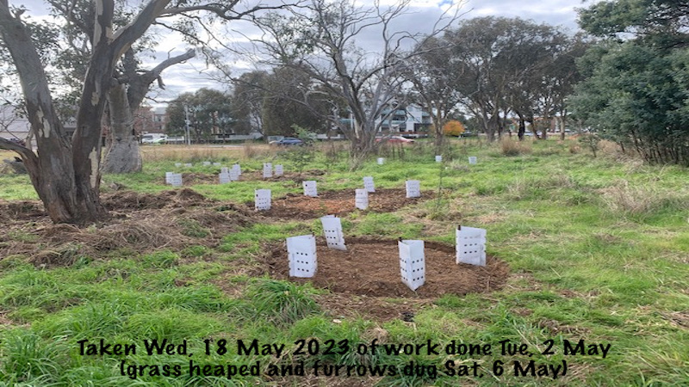
AS YOU GO PAST ON THE TRAIN YOU’LL SEE THE RANGERS HAVE PILED WOODCHIPS AND OTHER RESOURCES STRATEGICALLY SO THAT THE EXOTIC GRASSES CAN BE STRIPPED IN SOME CASES AND PREVIOUS TREE SEEDLINGS CAN GET A SECOND CHANCE.
THOSE YOUNG ROSELLAS DESERVE ACCESS TO NEGATIVE GEARING. IT IS SERIOUSLY OVERCROWDED.
JUST CONTACT PARKCARE ACT – AND GET INSURANCE COVER BY SIGNING UP
GRAB A SHOVEL AND SOME BOOTS AND VOLUNTEER YOUR TIME.

Slide 11
1
peel back small (3x4m) amoeba shaped patches of exotic grass (borders spray painted by Rangers)
2
shake off the dirt and heap the exotic grass in the centre to compost
3
dig a small furrow around the perimeter
(to contain mulch and compost and create a raised edge to trap moisture)
4
mulch the whole patch with wood chips (when the dead grass is fluffy and clear of soil )
5
plant (or transplant) clusters of 5-6 native trees inside the raised edge perimeter and water them
DIGGERS >
COMPOSTERS >
FURROWERS >
MULCHERS >
PLANTERS >
THIS IS AN ‘IDEA’ – IT IS NOT (PRESENTLY) AN ATTEMPT TO TAKE OVER YOUR PLANET – ALTH0UGH AN OVER 60s WORK FOR THE DOLE SCHEME MAY HAVE TO BE IMPOSED BY MIND CONTROL MECHANISMS ON THE MOTHER SHIP IF THINGS KEEP GETTING WORSE
SAFETY: WHISTLE BLOW = ANNOUNCEMENTS > FIRST AID AT HANGING ‘D’, ‘C’, ‘F’, ‘M’, ‘P’ BAGS > TOOLS BACK TO DEAD TREE > ALL OUT BY 1 : 15 pm

